Slide 1
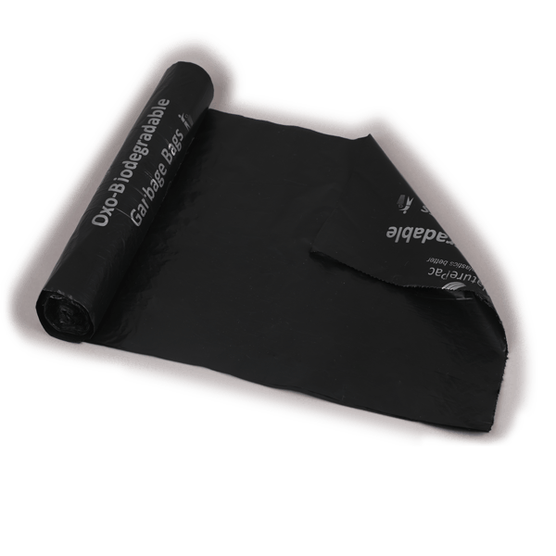


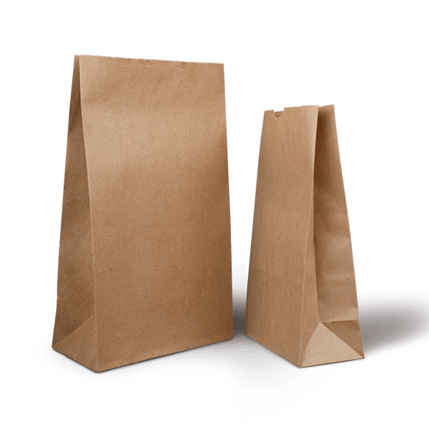
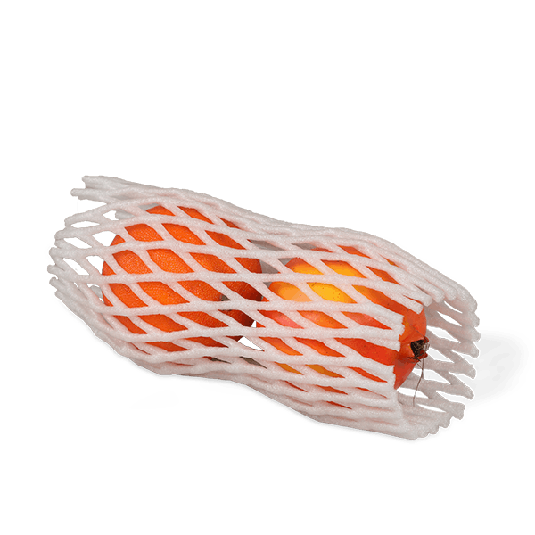
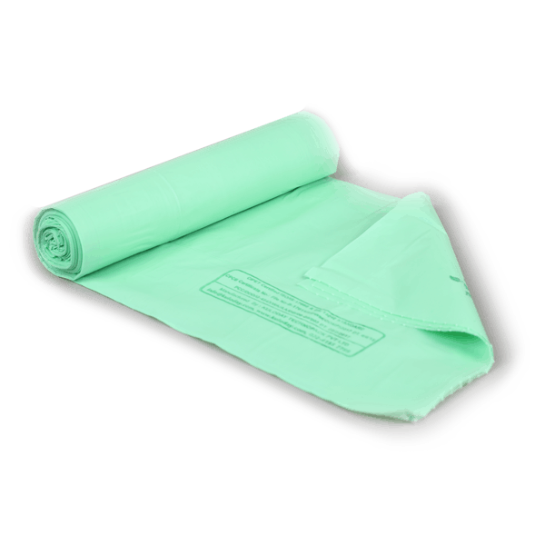
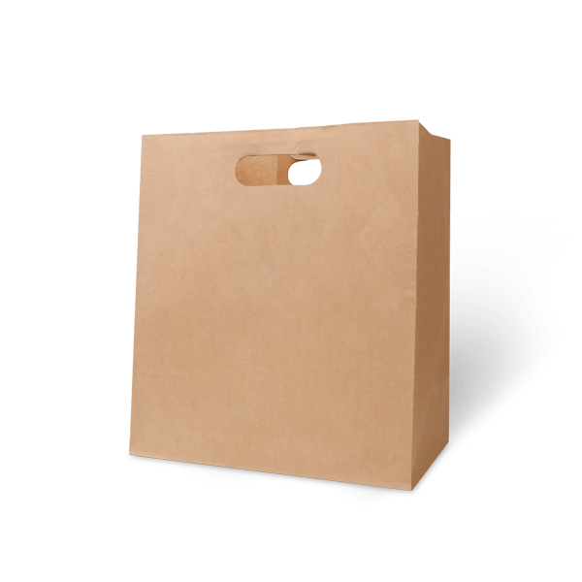
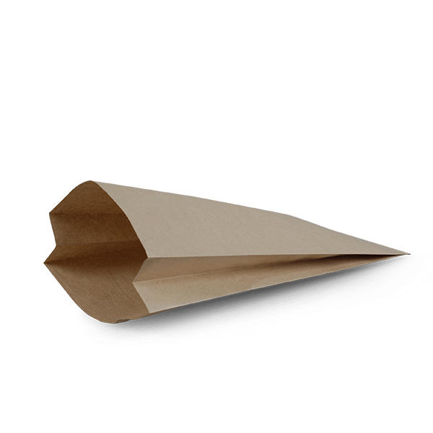
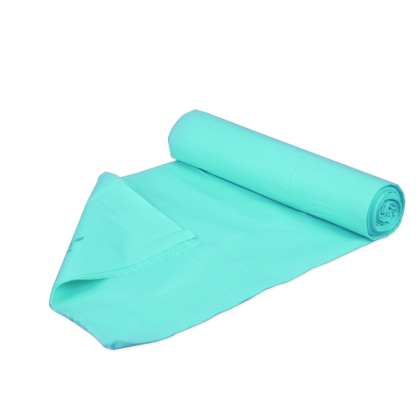

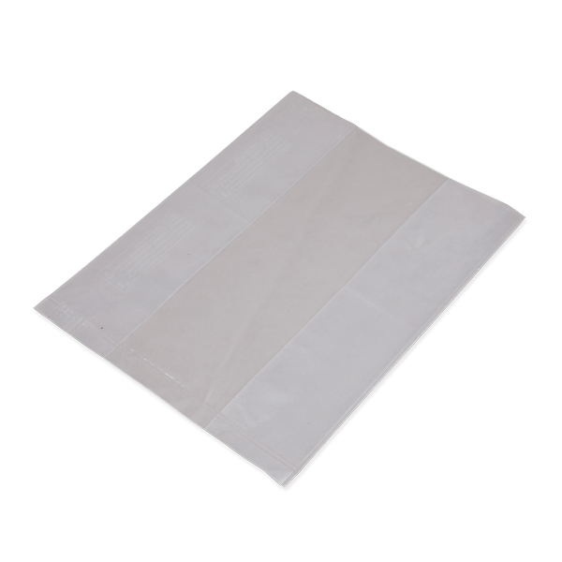
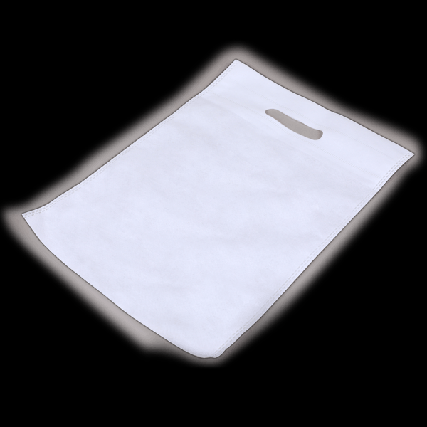
CARRY BAGS
1. Paper Bags 2. Grocery Bags 3. Plastic Bags 4. Eco-Friendly Bags
Squared Bottom
Oxo-biodegradable bags
Jute bags
Loop handle
EPE Net bags
Compostable bags
Pinched Bottom
D Cut
HDPE roller bags
Cotton bags
LDPE bags
Non-Woven plastic Bags

Slide 2
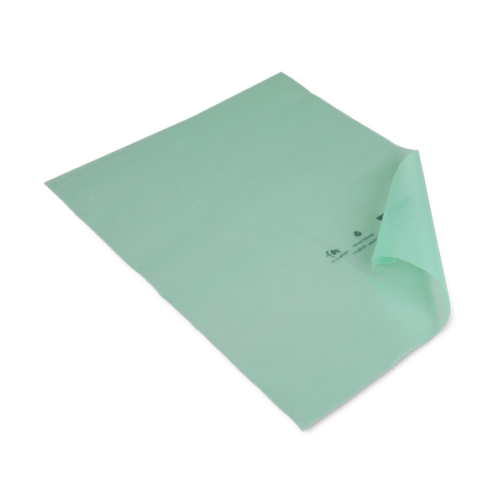
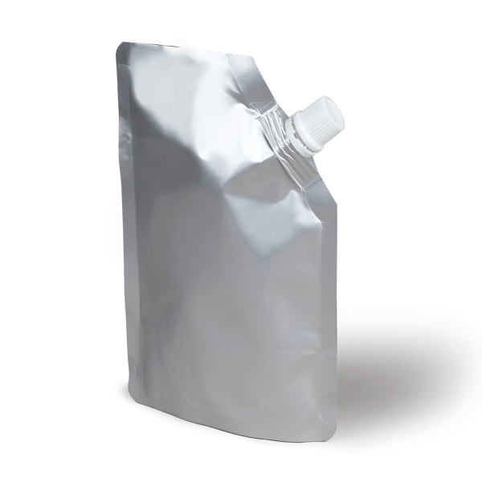


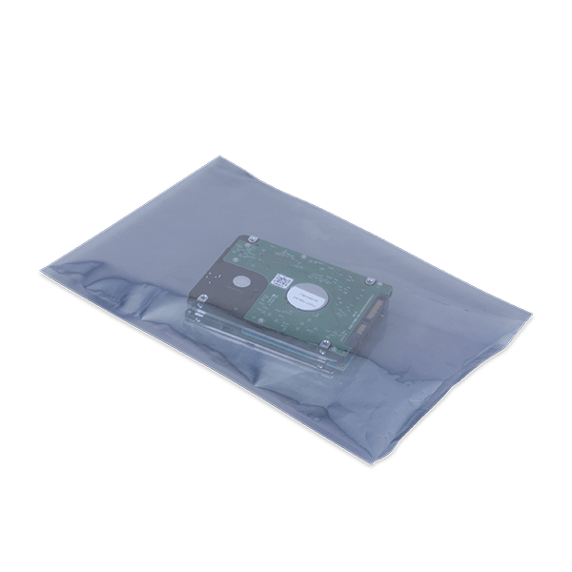
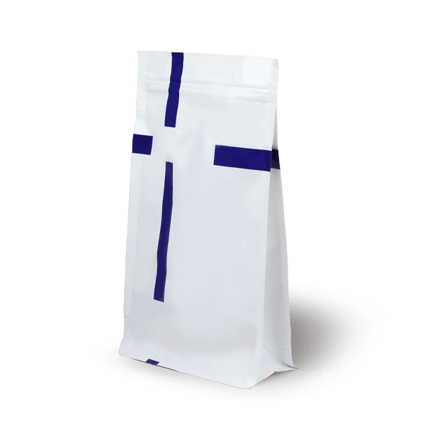

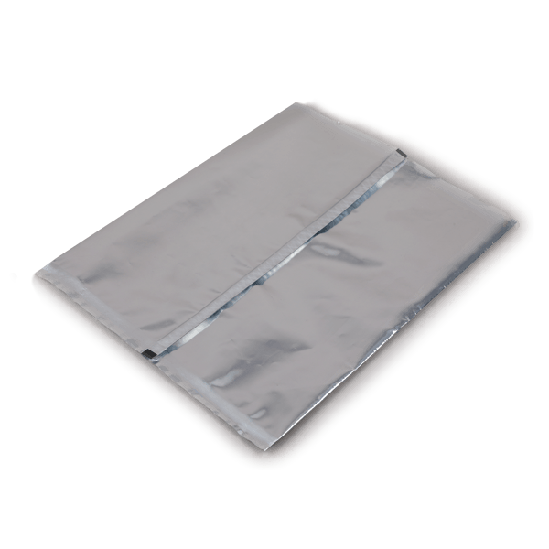
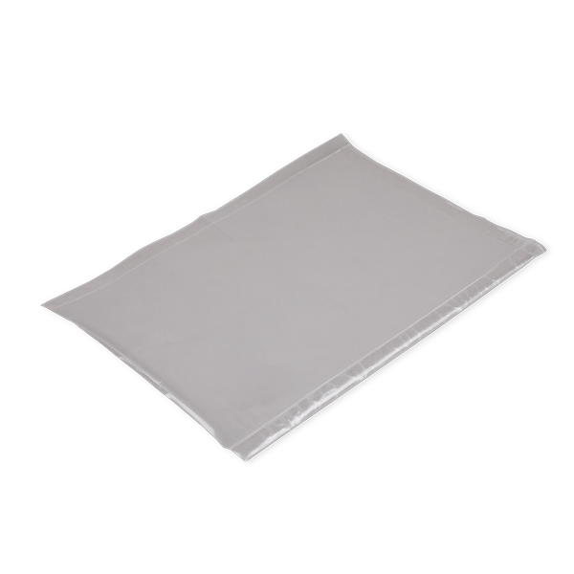
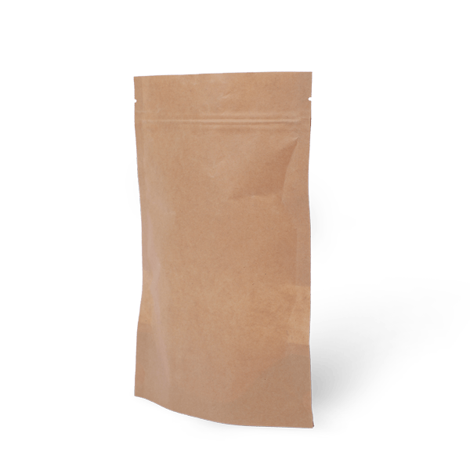
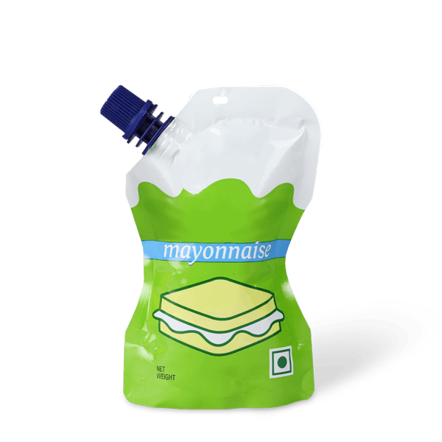
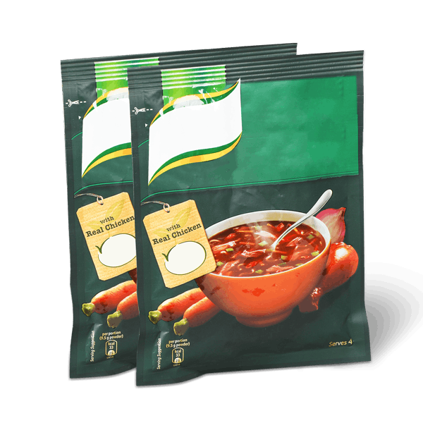
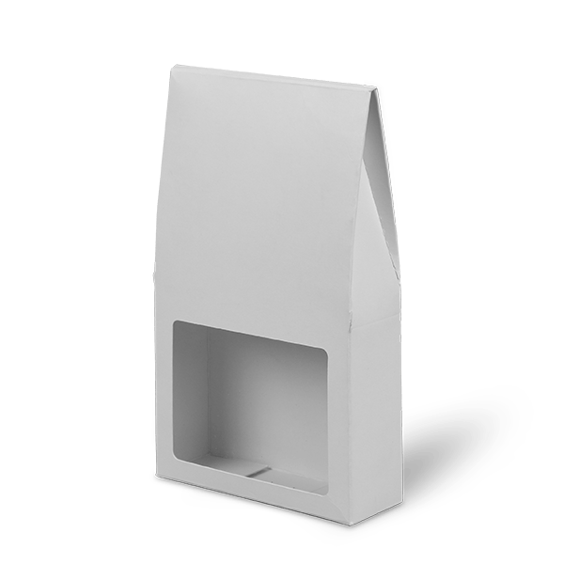
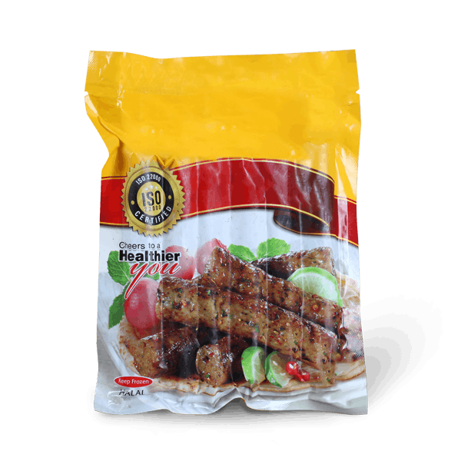
POUCHES AND TUBES
1. Special Application Pouch 2. Gusseted Pouch 3. Tubes 4. Sealed Pouches
VCI
3/4 Side seal
Spouted Bottom Gusset
Co-extruded
ESD
Bottom side Gusset
Laminated
Center sealed
Vacuum
Ziplock bottom Gusset
Die-Cut
Retort
Window patch
Frozen Pouches

Slide 3
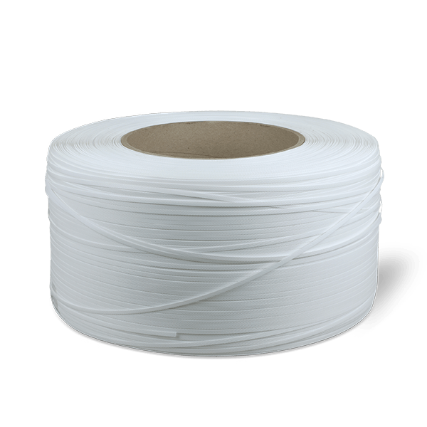
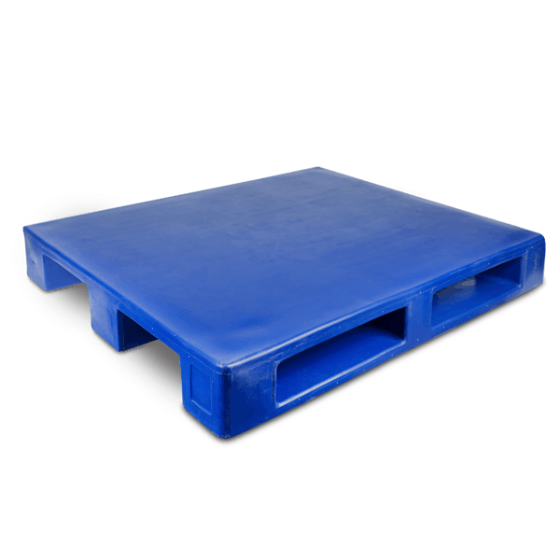
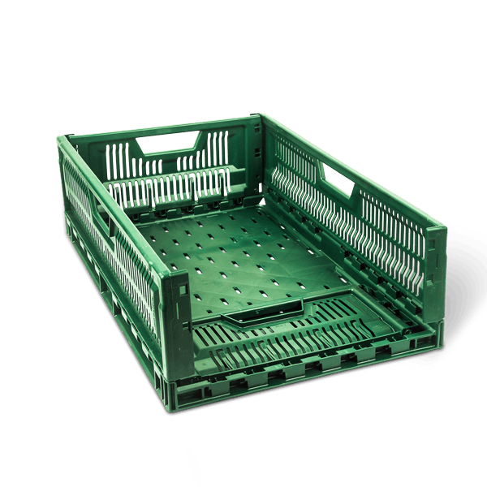
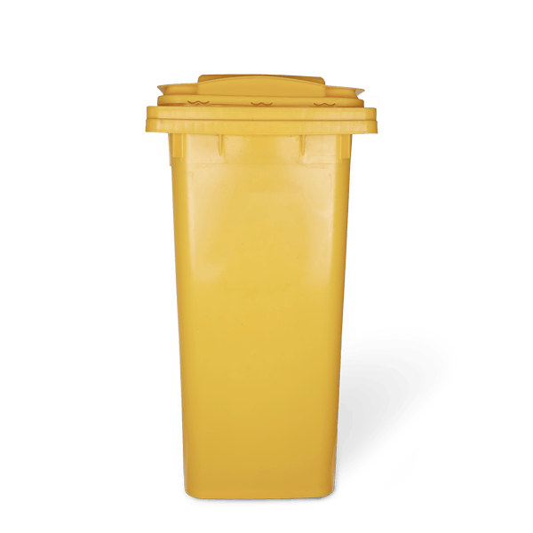

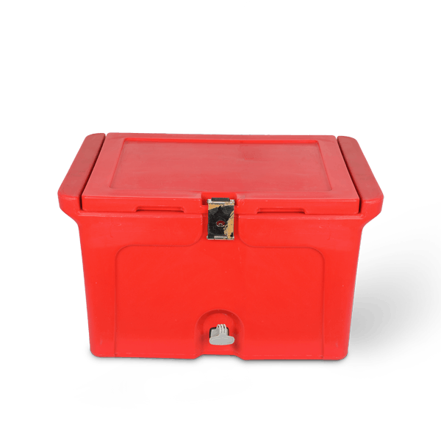
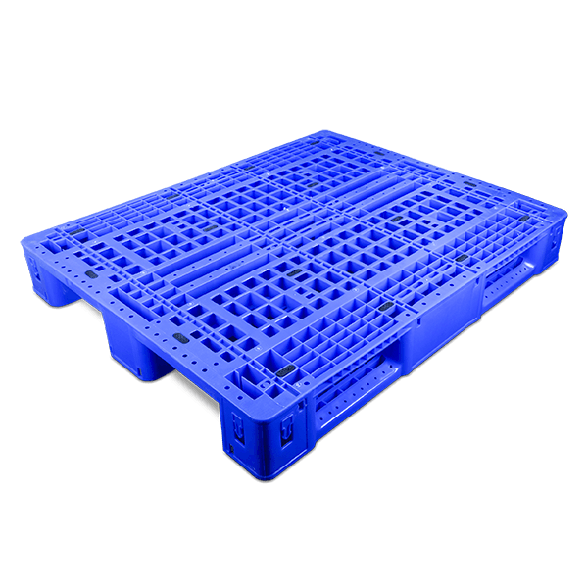
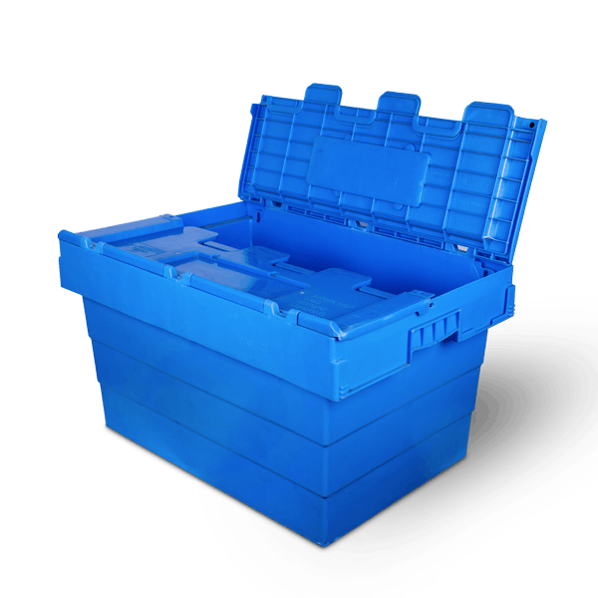


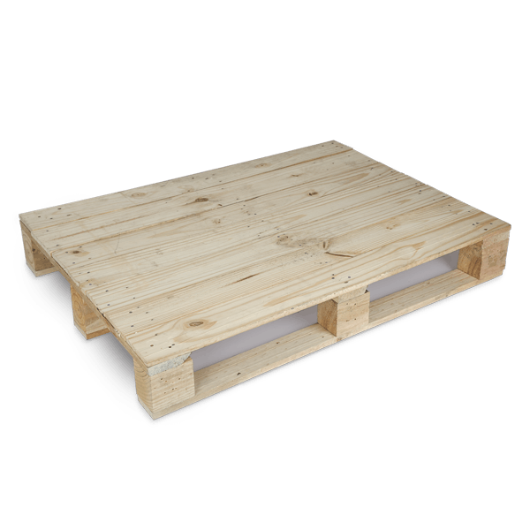
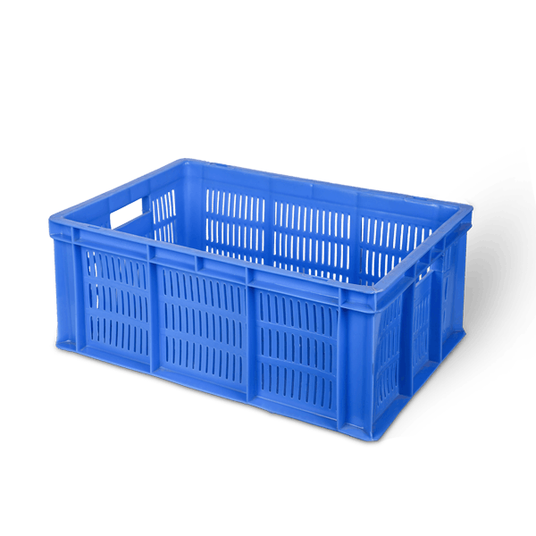
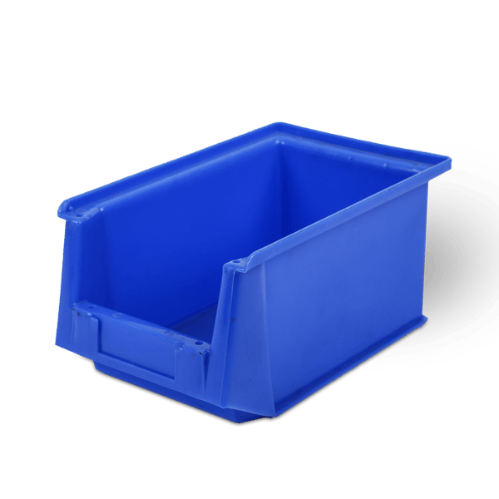

MATERIAL HANDLING
1. Straps 2. Bins 3. Seals 4. Pallets 5. Crates
Roto-molded pallets
Foldable crates
PP Straps
Dustbins
Flap Seals
Injection molded pallets
Nestable stackable crates
Icebox
Cable ties
PET Straps
FPO Bins
Wooden pallets
Standard crates
Bolt seals

Slide 4
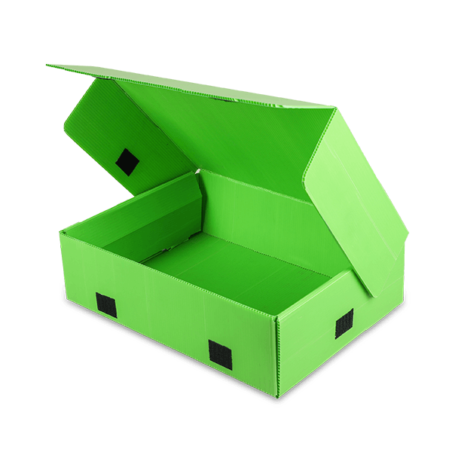


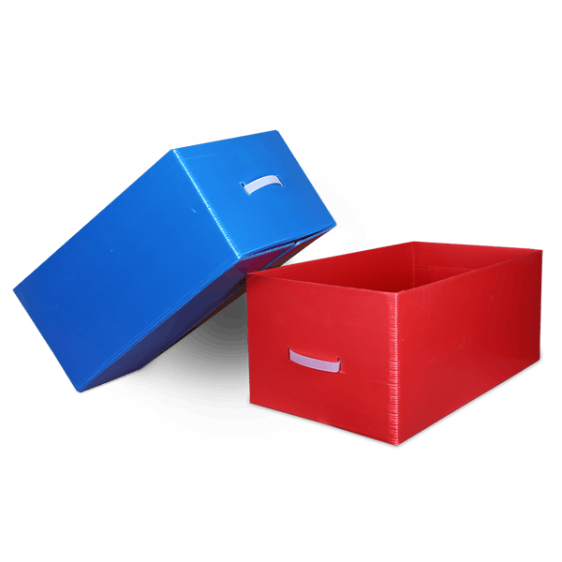
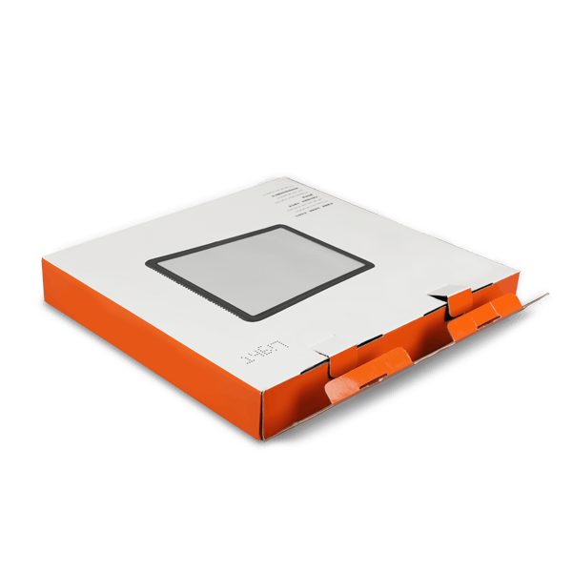
SHIPPERS
1. PP Corrugated Box 2. Master Cartons
Telescopic
Self-locking
Regular Slotted
Regular slotted
Fully overlapped

Slide 5
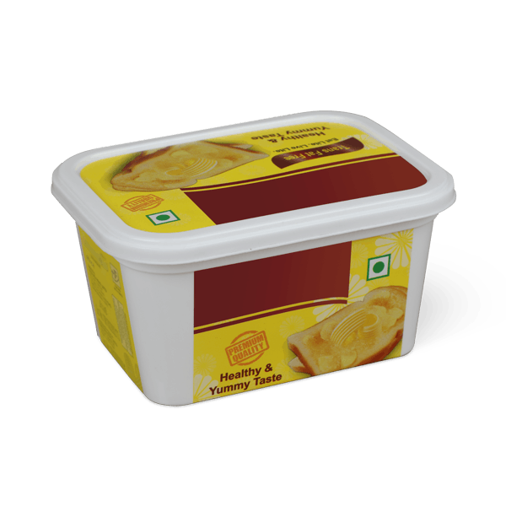
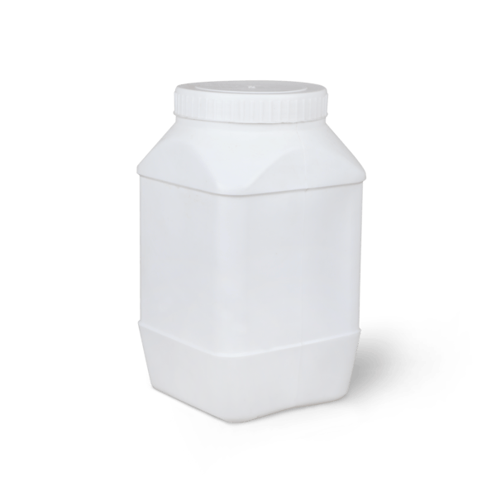
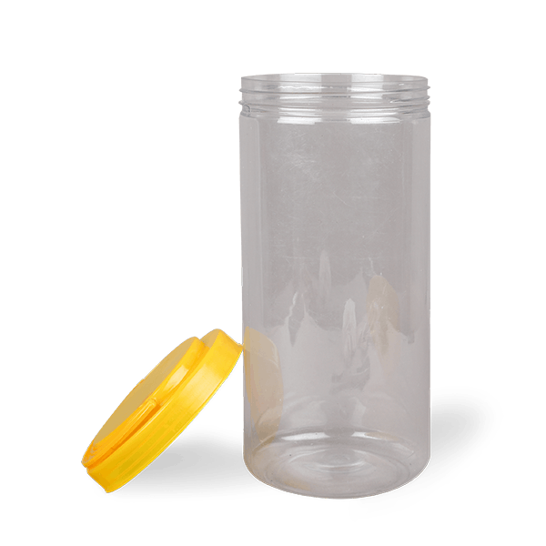
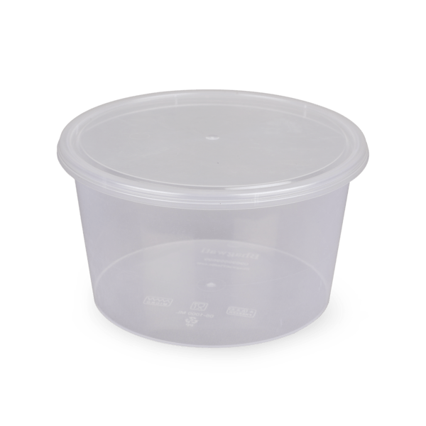
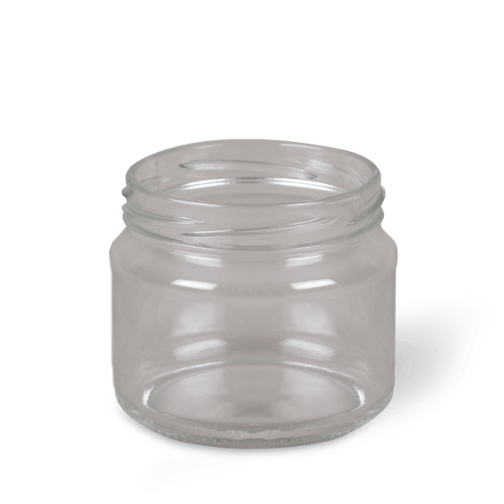
Wide Mouth Containers
1. Injection Moulded Containers 2. Blow Moulded Jars
HDPE containers
IML containers
PET containers
PP containers
Glass jars

Slide 6
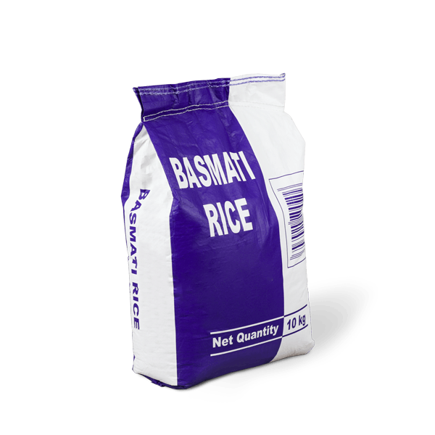
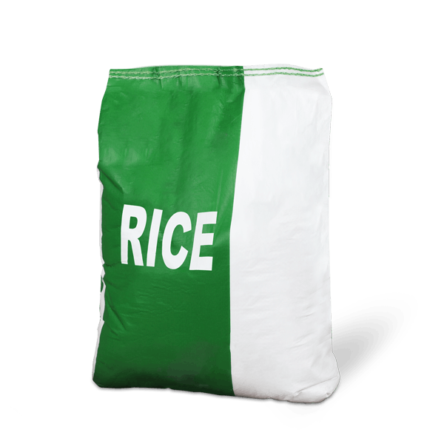


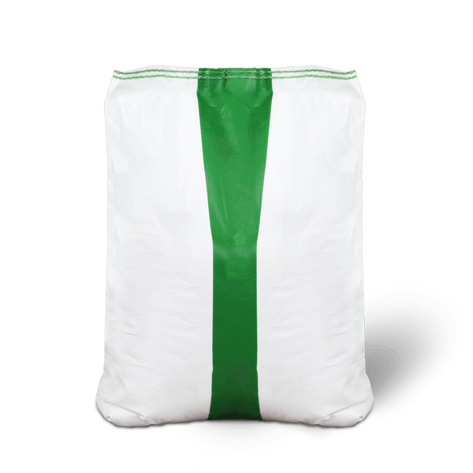
SACKS
1. Woven Sacks 2. Non Woven Sacks
HDPE Woven Sacks
PP Sacks
Jute Woven sacks
Multi-wall Kraft Snacks
PP Woven Sacks

Slide 7


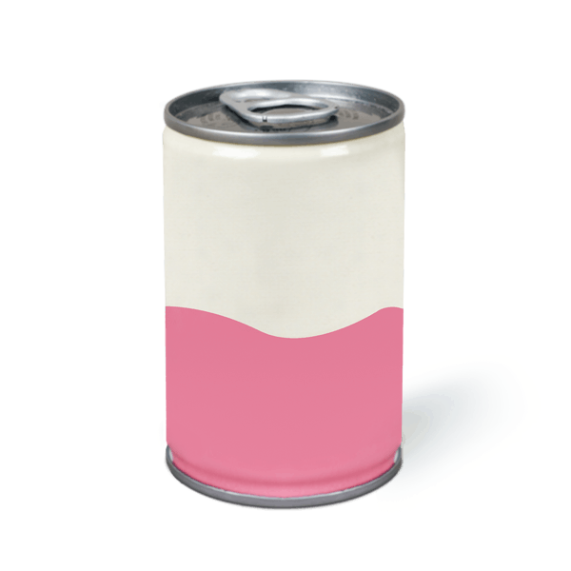

Metal Cans
1. Three Piece Tin Cans 2. Two Piece Aluminium Cans
Can with press fit lid
Cans with aerosol dispensing
Can with easy open end
Can with easy open end

Slide 8
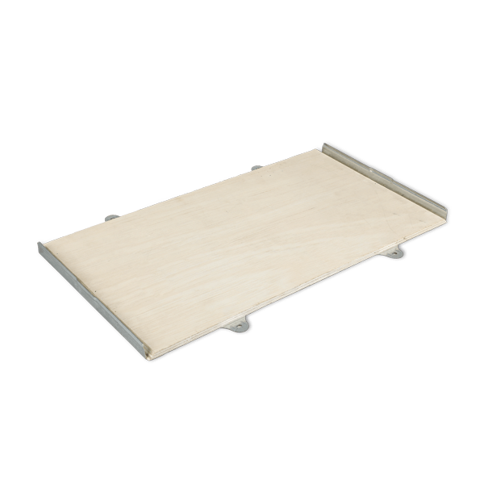
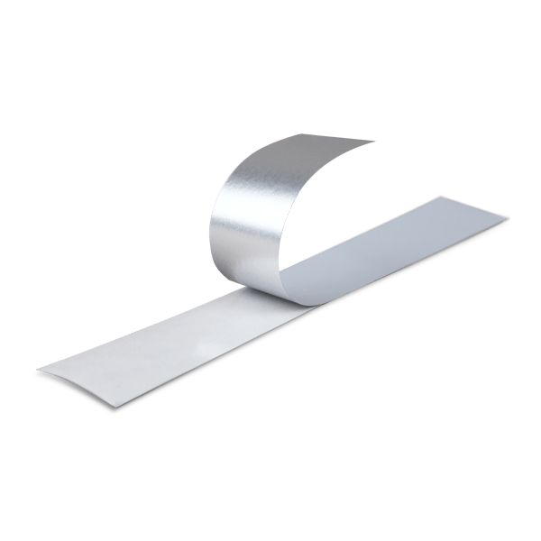
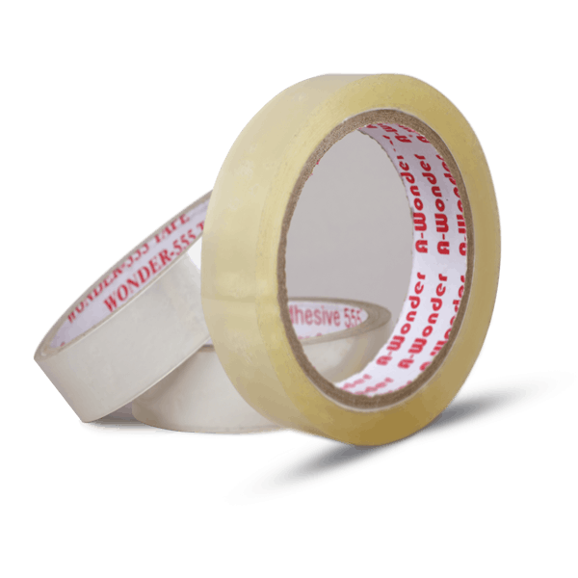
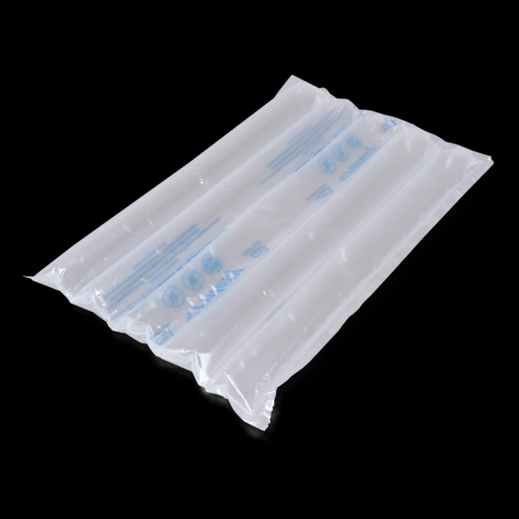
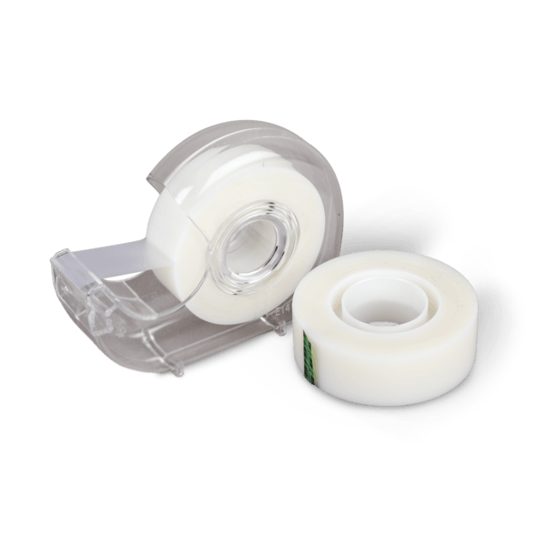
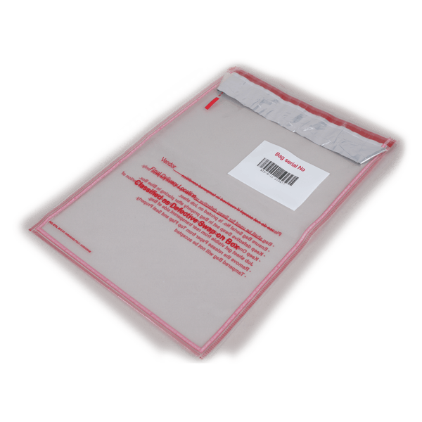


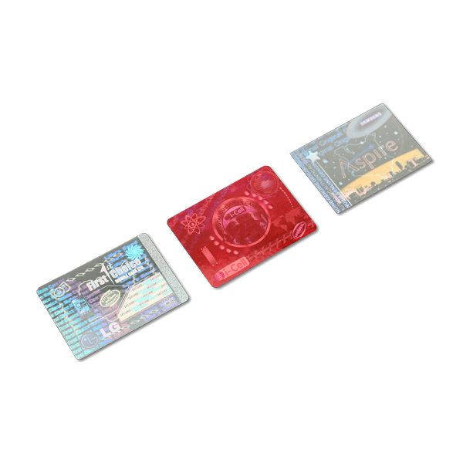

Protective Packaging
1. Security Printing 2. Boards-Planks 3. Tapes 4. Cushioning Void Solutions
Tamper evident tape
Wooden planks
BOPP tapes
Air columns /pillows
Barcode
Scotch Tapes
Paper filler
Hologram
Two-sided tapes
Thermochromic label

Slide 9
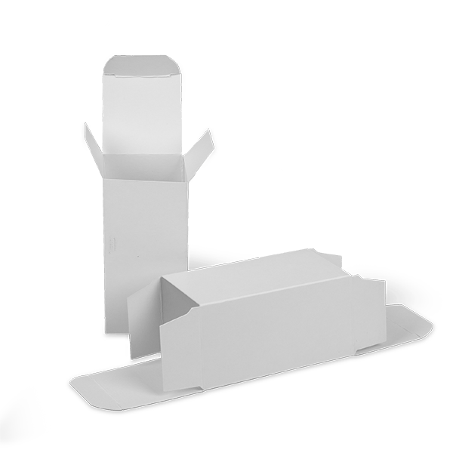











Cartons
1. Monocartons 2. Hardboard Boxes 3. Fluted(E/F)Cartons
Straight Tuck End
Top Bottom
Self-locking Fluted Cartons
Auto Lock Bottom
Magnetic Lock
Pasted Lock Bottom Fluted Cartons
Reverse Tuck End
Collapsible Box
Pasted Lock Bottom
Auto-lock bottom cartons
Lined
Slider Box
Window patch

Slide 10





Labels And Sleeves
1.Sleeves 2. Labels
Self-adhesive labels
Paper sleeves
Heat Transfer labels
Shrink sleeves
Direct thermal labels
Shrink labels
In-mould labels

Slide 11








Non Paper Based Products
1. Cutlery 2. Trays 3. Bowls
Wooden Cutlery
Cornstarch Tray
Bagasse bowl
Bagasse Tray
Plastic bowls
Plastic Cutlery
Foil Containers
Multi-compartment Tray

Slide 12













Paper Based Products
1. Cups and Glasses 2. Envelopes 3. Food Boxes 4. Paper Types
Copier paper
Burger boxes
Printed paper envelopes
Ripple walled Cups
Paper trays
Bubble envelope
Specialized papers
Kraft Envelope
Tissue paper
Cloth mesh line envelopes
Sandwich Cartons
Pizza box
Kraft Envelope

Slide 13


CLOSURES
Caps
Screw Caps
Snap Fit Caps

Slide 14





PREFORMS
PET Preforms
CTC Preforms
Amber Preforms
HF Preforms
Alaska Preforms
ROPP Preforms

Slide 15



Bulk Packaging
1. Intermediate Bulk Pack 2. Large Bulk Pack
Square Tin Containers
Open Top Drum
Closed Top Drum

Slide 16




Narrow Mouth Containers
Blow Moulded Bottles
HDPE Bottles
HDPE Jerry Cans
PET Bottles
Glass Bottles

Slide 17



COURIER BAGS
Poly Courier Bags
Bubble bags
Plain courier bags
Courier bags with Zip lock

Slide 18


Paper Products
Paper Tubes
Cores
Paper Canisters

Slide 19



Films
Wrapping Films
Stretch Film
Shrink Film
Cling Film

Slide 20



Laminates
Roll Form
Monolayer
Multilayer
Recyclable

